Slide 1
Wright Farms Metropolitan District
January 4, 2024
Notes:
Welcome to the Wright Farms Metropolitan District public Board meeting. Thank you so much for coming. As a reminder these meetings are held the first Thursday of every month – usually at the Anythink library – currently the library is being renovated so we will be holding this meeting and the February meeting virtually. All meeting information can be found on the WFMD’s website

Slide 2
Q & A Session: Wright Farms Metropolitan District’s Service Plan Amendment
Trash and Recycling Services
Notes:
This is a presentation where we will present on the trash and recycling services the WFMD is proposing to provide to District residents and hopefully answer questions you might have regarding the Wright Farms Metropolitan District providing these Services to District residents. At this end of this presentation we will open up the floor to any additional questions you might have.

Slide 3
Introduction: Wright Farms Metropolitan District’s Board of Directors
James A. Ray (President)
Heidi Farfel (Secretary)
Kris Simons (Treasurer)
Nsesa Kazadi (Assistant Secretary)
Notes:
Before we begin the presentation, I want to introduce you the Wright Farms Metropolitan District's Board of Directors – all Directors are residents of the Wright Farms Metropolitan District and might even be your neighbor!

Slide 4
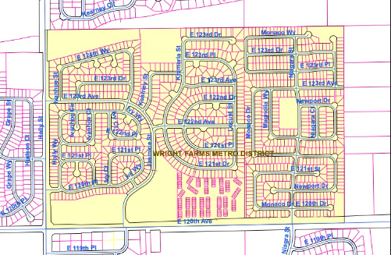
What is the Wright Farms Metropolitan District?
The Wright Farms Metropolitan District is a local government that maintains the parks, community landscaping, a portion of the Brantner Gulch nature trail, and certain perimeter fencing within the Wright Farms, Holly Crossing, and Jasmine Estates subdivision.
Notes:
The WFMD is a local government located in unincoporated Adams County that provides a variety of services to its residents. These services include landscaping throughout the community, maintenance of the Wright Farms and Holly Crossing parks, playgrounds, and basketball and tennis courts. The WFMD also maintains a portion of the Brantner Gulch nature trails and some perimeter fencing within the community.
Local governments such as the WFMD primarily operate under their main organizational document – a service plan.

Slide 5
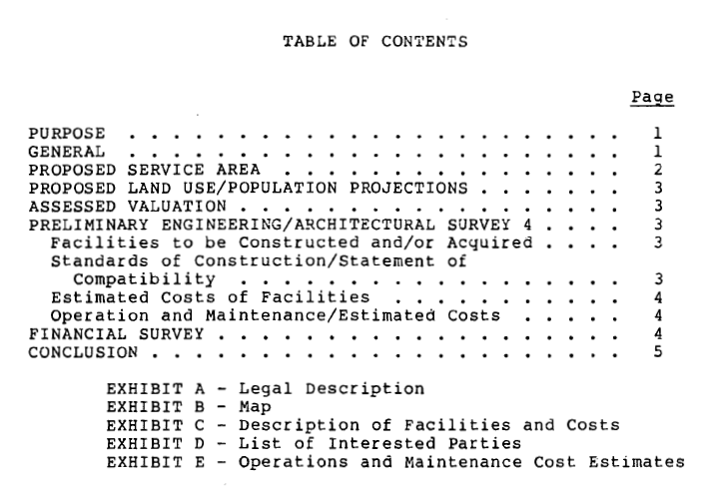
What is a Service Plan?
A document that outlines the purpose, boundaries, powers, functions, and financing mechanisms of the special district.
Notes:
Wright Farms Metropolitan District’s Service Plan is its governing document . It includes information such as the district's goals and objectives, organizational structure, services it performs, and its funding mechanism, which includes property taxes.
The service plan is a crucial tool for both the governing body of the special district and the residents within its boundaries. It helps ensure transparency, accountability, and effective management of the services provided by the special district.
To the right is the table of contents for Wright Farms Metropolitan District’s Service Plan

Slide 6
What is a Service Plan Amendment?
A Service Plan Amendment amends the original Service Plan.
The District desires to amend its Service Plan to provide collection and transportation of trash and recycling for District residents.
Notes:
If a local government such as WFMD wants to modify its original service plan it can do so through a service plan amendment. WFMD is amending its service plan to include the provision of trash and recycling services.

Slide 7
Why Have Trash and Recycling Services Not Been Provided in the Past?
Prior to 2020 the Wright Farms Metropolitan District was not eligible to provide Trash and Recycling Services.
Notes:
Why is the District now amending its service plan?
Prior to 2020 due to a change in law regarding population requirements the District was not eligible to provide these services – now it can

Slide 8
Who Will Receive Trash and Recycling Services?
Trash and Recycling Services will be mandatory for all residents of the Wright Farms Metropolitan District.
These Trash and Recycling Services will not be provided to the Jasmine Estates subdivision as this subdivision already receives trash services from a single trash provider.
Notes:
These trash and recycling services will be mandatory for all residents of WFMD – except for residents located in the Jasmine Estates subdivision who already receive trash and recycling services from a single provider through their HOA.

Slide 9
What Does the Proposed Service Plan Amendment Say?
“The District may provide solid waste collection and transportation for residents within its boundaries.”
Notes:
The District wants to be incredibly transparent with District residents. This was the language in the service plan amendment. This amendment if approved will give the District the power to provide trash and recycling services to its residents through a single service provider

Slide 10
Does the Proposed Service Plan Amendment Change Anything Else in the Service Plan?
In fact, the proposed amendment states, “Except as expressly set forth in this First Amendment all provisions of the Service Plan remain unchanged and in full force and effect.”
Notes:
The Service Plan Amendment does not detract from any services WFMD already provides

Slide 11
What Will These Trash and Recycling Services Cost District Residents?
Trash and Recycling Services will be paid for from the District’s property tax revenue.
No intent to increase property taxes to provide for these Trash and Recycling Services.
No intent to impose any fees to provide these Trash and Recycling Services.
Notes:
I know many of you are wondering how these trash and recycling services will be paid for. They will be paid for from property taxes. However, the District is not intending to raise the property taxes to pay for these services.
The District Board also has no intention impose a fee to pay for these services.
The District Board learned how much trash services were costing District residents and realizing the District can get a better price for these services – wanted to pay for these services directly. While savinsg will vary across the community, we did speak with one District residents who will save approximately 720 annually when the district provides trash and recycling services

Slide 12
Wright Farms Metropolitan District’s Mill Levy Over Time
Mill Levy
Notes:
The WFMD does not intend to increase property taxes to provide for the trash and recycling services. Over the past 6 years the District has reduced its mill levy year on year. This year the District again decreased its mill levy from 12.5 mills to 10.5 mills.

Slide 13
Has the District Chosen a Trash and Recycling Services Provider?
No.
Before hiring a Trash and Recycling Service provider, the District must publish an invitation to bid.
Trash and Recycling Service providers can submit proposals for providing Trash and Recycling Services for District residents.
This process enables the District to choose the best possible contractor that suits the needs of the District’s residents.
Notes:
No trash services provider has been discussed or chosen.
We will have to publish an invitation to bid for this services agreement – by getting different proposals from different providers the District can choose the best provider to suit the District’s residents needs.

Slide 14
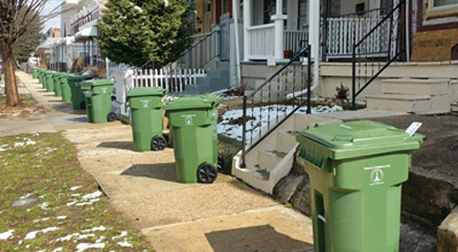
Why Does the District Think That Providing Trash and Recycling Services Will Be Beneficial?
Improved Neighborhood Aesthetics
Improved Safety
Reduced Traffic
Notes:
Using a single trash service provider will allow for improved aesthetics via similar trash cans throughout the community and a reduction in the number of days on which trash cans are on the street pending or following trash pickup.
Additionally, Reduced number of hours and days on which trash truck operate withing the District will reduce the risk of accidents and improve safety within the neighborhood, especially for pedestrians.

Slide 15
How Will Providing Trash and Recycling Services Decrease Traffic?
 | Number of Trips/Week/Month | Time and Length of Trips
If the District Exclusively Provides Trash Services Per the Proposed Service Plan Amendment | Two trash trucks per week on a single day. Two recycling trucks every-other-week on a single day. Total Trips/Month = 12 trucks/month | Trash trucks are expected to provide services for approximately four hours per week. Recycling trucks are expected to provide services for approximately four hours, every other week. Total Hours/Month = 28 hours/month
Current Residential Trash Collection System | One trash truck per day, five days a week. At least five recycling trucks each week. Total Trips/Month = 45 trucks operating monthly | Trash and recycling services last approximately two hours per service. Total Hours/Month = 90 hours/month
Notes:
Currently 45 trash trucks total are operating within the District for approximately 90 hours every month.
If WFMD provides trash and recycling services only 12 trucks will operate within the District for 28 hours each month.

Slide 16
What Are the Next Steps?
Comments provided to Adams County on the District’s request to contract for Trash and Recycling Services.
Public Hearing in front of the Adams County Board of County Commissioners, who have to approve the District’s request. Date and Time To-Be-Determined.
Once Service Plan Amendment is Approved:
District will publish Request for Proposals for Trash and Recycling Services.
District will review responses and award a contract.
District will provide communication to community regarding timeline for transition so each homeowner can cancel services with their existing provider.
Estimate Start Date: July or August 2024.

Slide 17
Where to Direct Question and Comments Regarding Wright Farms Metropolitan District Providing Trash and Recycling Services?
Email all questions or comments you have about the Service Plan Amendment to GJBarnes@adcogov.org and/or erblawllc@erblawllc.com.
Comments are due by January 17, 2024.
Any further questions you have about this Service Plan Amendment and the Wright Farms Metropolitan District providing Trash and Recycling Services to District residents can be directed to erblawllc@erblawllc.com.

Slide 18
Questions?

